Slide 1
Peeking at a Monochromatic Scene

Slide 2
Peeking at a Monochromatic Scene
Description:
You will learn about atmospheric perspective.
You will design a landscape composition from the perspective of looking through a keyhole, hole in a fence, or other small view.
You will then paint the landscape with a monochromatic color scheme.
Students will:
- review color theory by identifying various color schemes.
- explore value, tints, shades, and tones of a hue.
- consider different viewpoints in a composition and how they communicate to the viewer.
- demonstrate atmospheric perspective in a landscape painting.

Slide 3
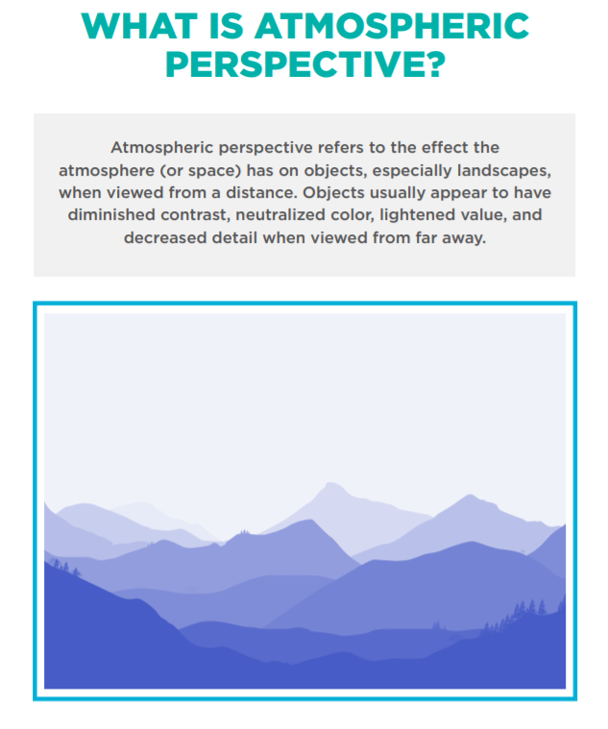

Slide 4
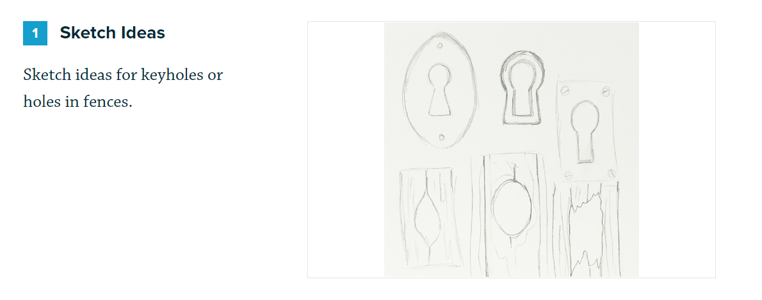

Slide 6
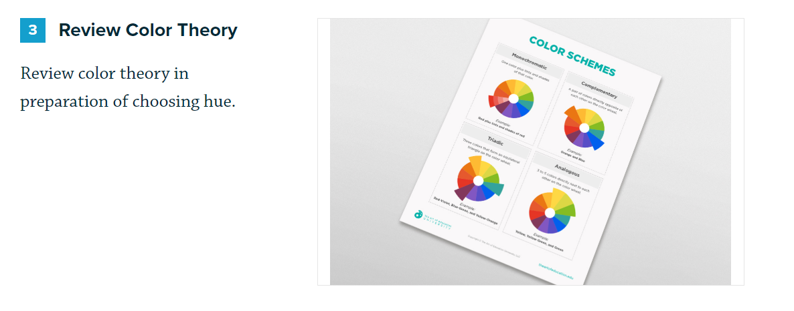

Slide 8
A tint is when you add white to a hue to make it lighter.
A shade is when you add black to a hue to make it darker.
When you add grey to a hue, the resulting color is referred to as a tone.

Slide 9
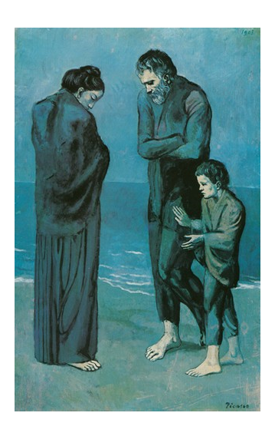
Picasso used a blue monochromatic color scheme in many of his paintings representing his "Blue Period" between 1901 and 1904.
His paintings from this period were very somber and the blues help convey feelings of sadness, grief, and depression.
This painting is called The Tragedy (1903).

Slide 10
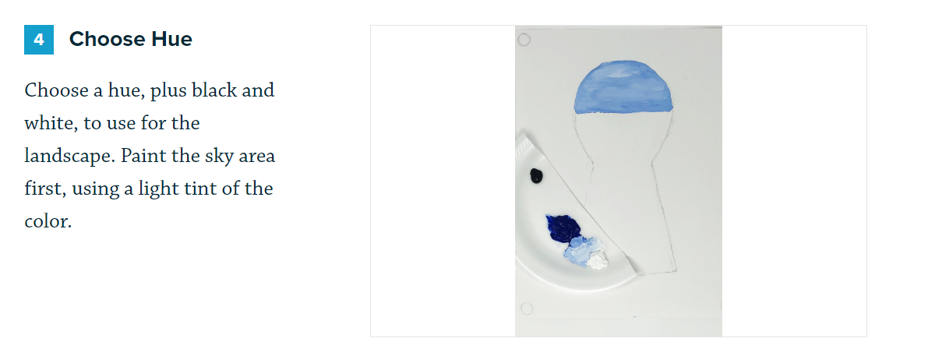

Slide 11
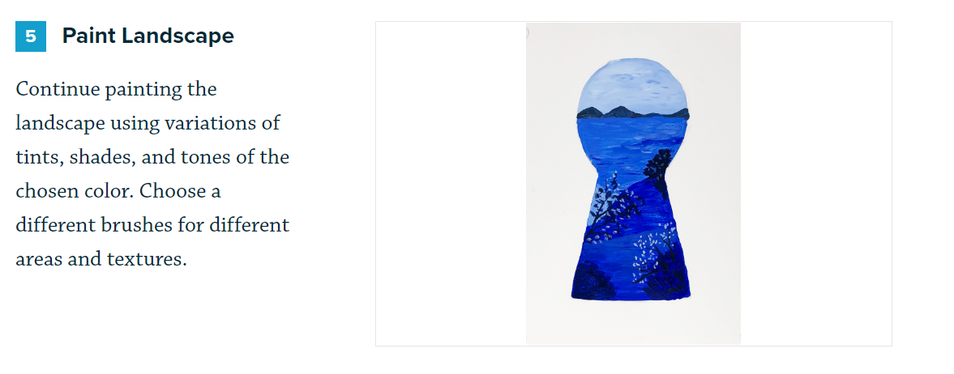

Slide 12
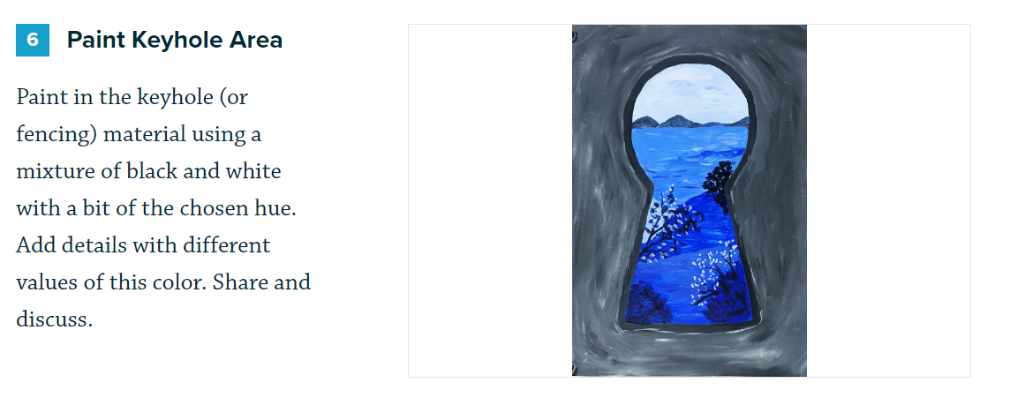

Slide 13
References:
What is Atmospheric Perspective, https://dl.airtable.com/.attachments/074f97bb3f6b862be6a92faf1aed697d/3335fe68/WhatIsAtmosphericPerspective1.pdf
Color Schemes, https://dl.airtable.com/.attachments/5ff0e8fc722ed631f5fd7a25643f7c70/adfd2c91/ColorSchemes.pdf
Tints and Shades: excerpt from Color Schemes Smart notebook doc by michael.mcewing@nbed.nb.ca

